Slide 1
Under the guidance of:
Dr. Somesh Kumar (Assistant Professor)
ICTW Project Presentation
Sanitizing (UV light) Remote Control Robot
Group Number: xyz
Team Members:
Ansh Singh: IMT2020-013
Arun Singh Kushwaha: IMT2020-016
Lucky Kumar: IMT2020-051
Ritik Kumar:IMT2020-080

Slide 2
Objective
The objective of this project is minimizing human association as much as possible and thus automating the tasks such as sanitization with the help of robots. In this case, the use of robots can reduce human exposure to pathogens, which has become increasingly important as epidemics escalates.
Motivation
All of know about the COVID scenarios we cant talk, walk freely as we use to do if before because of the COVID and one of the way to prevent this virus from spreading is by minimizing the contact and proper sterilization or sanitization. It has been a very hectic process in current scenario to sanitize a very large area in very less time with the convectional methods (Spraying Disinfectant Liquid). Also, recently, the World Health Organization (WHO) has announced that it is really harmful to use disinfectant liquids regularly in public places so to prevent spreading and at the same time to sanitize the surface. To solve this problem, we have created Sanitizing (UV light) Remote Control Robot, which will sanitize a given room/ area with the help of UV lights.

Slide 3
Advantages of UV light over Disinfectant Liquid
One-time cost (No need to refill alcohol or chlorine liquid).
Can be used to disinfect surfaces, medical suits, medical masks, and other medical equipment.
Reduce the disinfection time by 60% when compared to liquid-based disinfection methods. (The drying time is considerably high when used in environments where fabric materials are available).
Ability to use for environments with electronic equipment.
One operator can cover a large area. ( No need of multiple people like in liquid sprays)
It has been proven by various research that UV light has a 99.997 % disinfection rate and it can easily kill COVID and other virus too

Slide 4
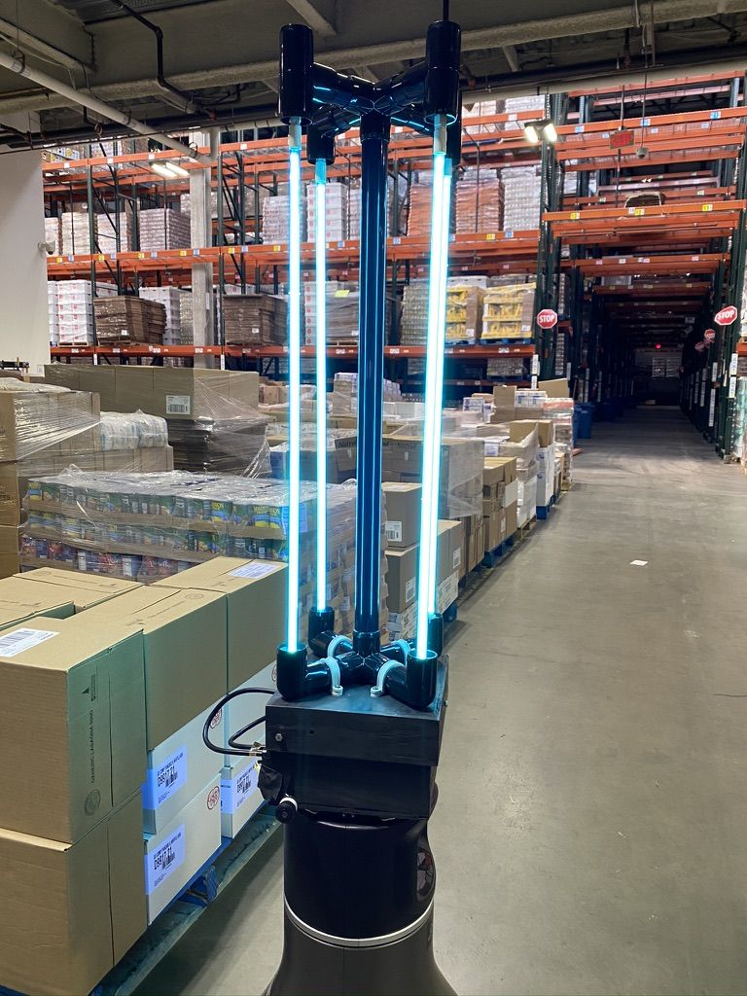
Application
This can be used in Hospitals, Banks, Malls, schools and many other place wherever there is a high chance of getting any kind of virus

